Slide 1
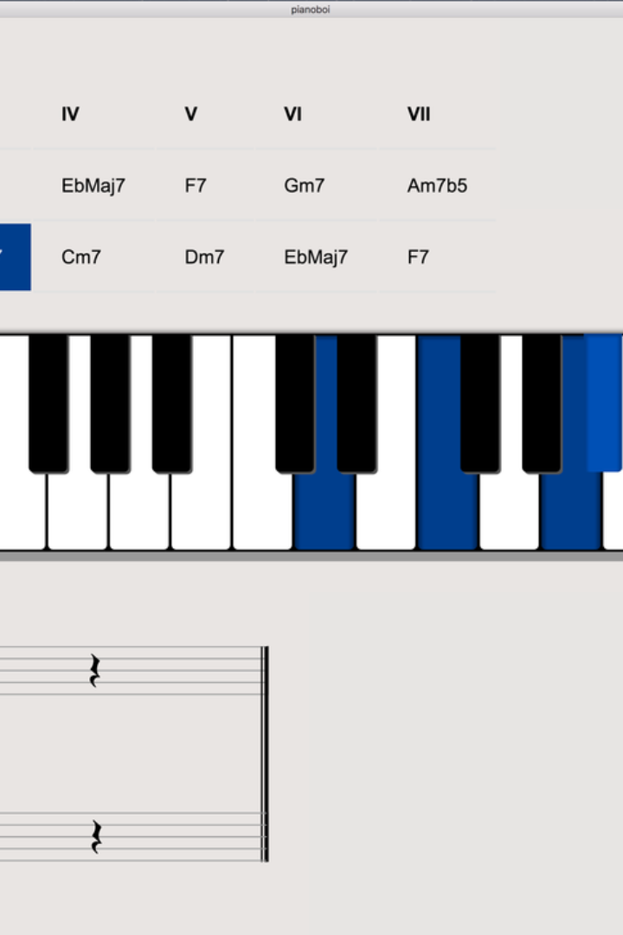
Interactive MIDI Musical Keyboard: Simplified Music Creation using Python
An interactive MIDI musical keyboard is a versatile and powerful tool for creating music using Python. It allows users to compose, arrange, and perform music interactively, making the music production process efficient and enjoyable.

Slide 2


Slide 3
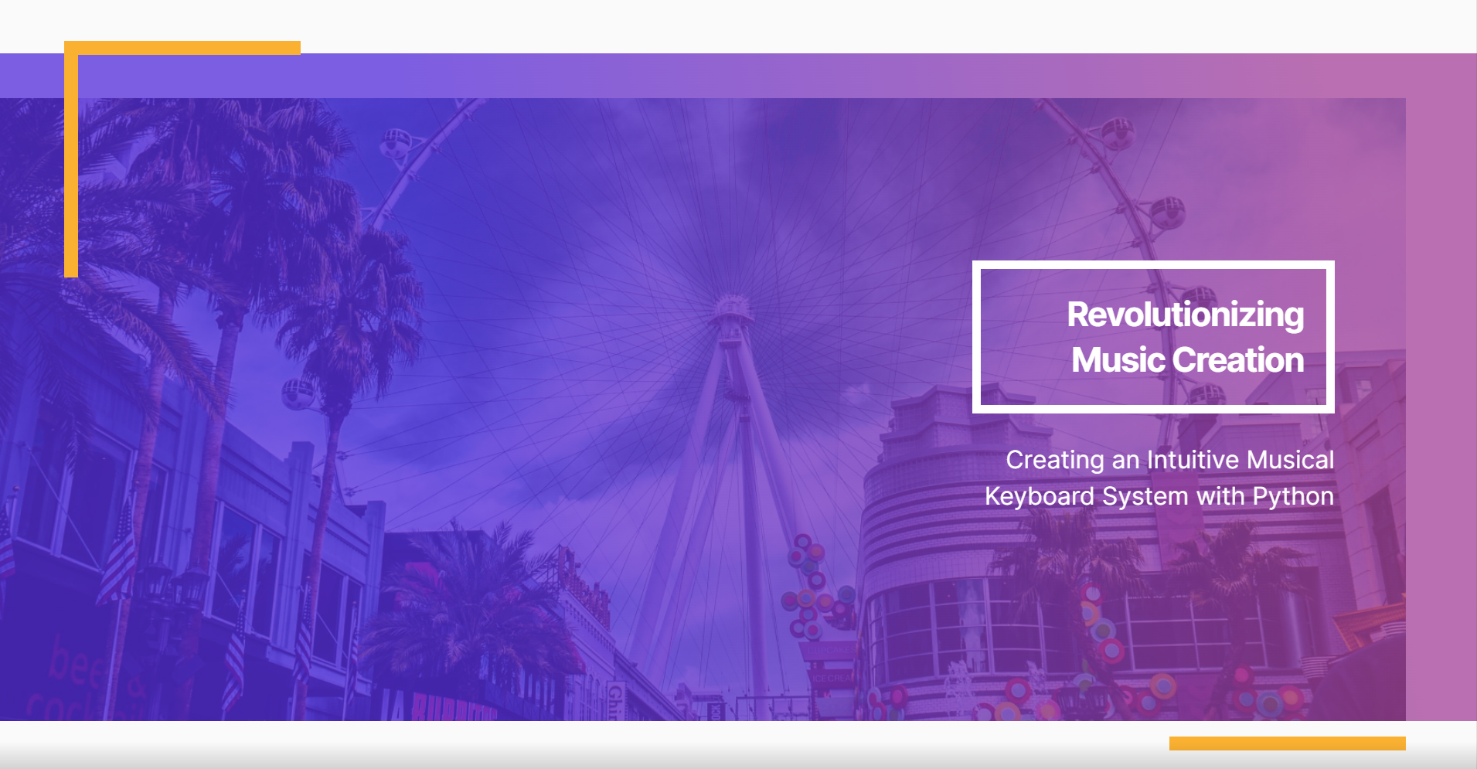

Slide 4
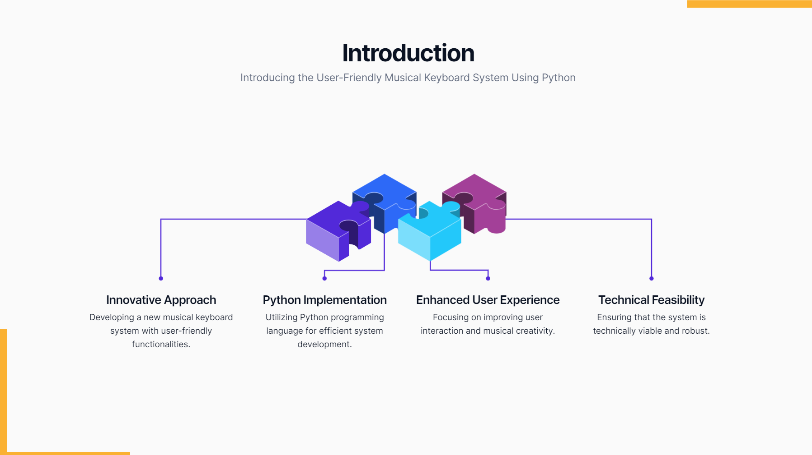

Slide 5
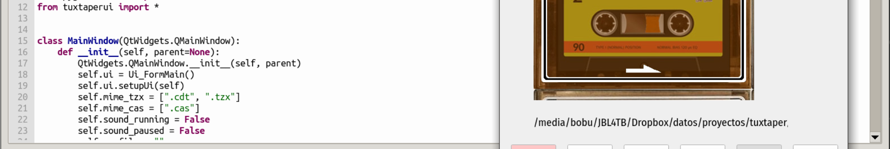
Benefits of Using Python for Music Creation
1
Flexibility
2
Scalability
3
Integration
Python offers a wide range of libraries and tools for music production, allowing for flexibility in creating various musical compositions.
With Python, musicians can scale their music projects smoothly, whether it's a simple melody or a complex symphony.
Python seamlessly integrates with different music production software and hardware, providing a comprehensive environment for music creation.

Slide 6
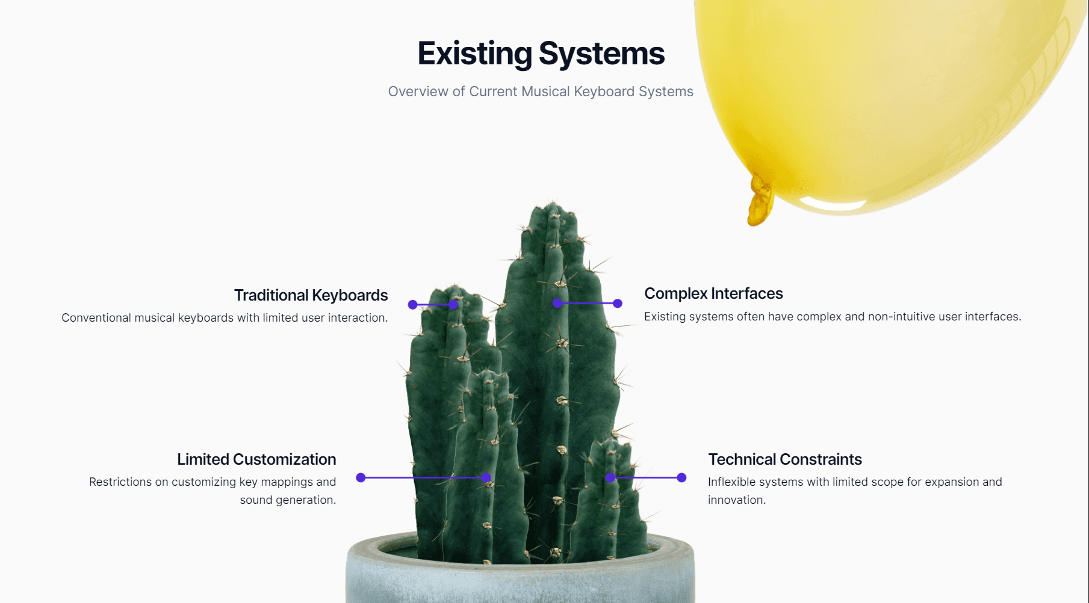

Slide 7
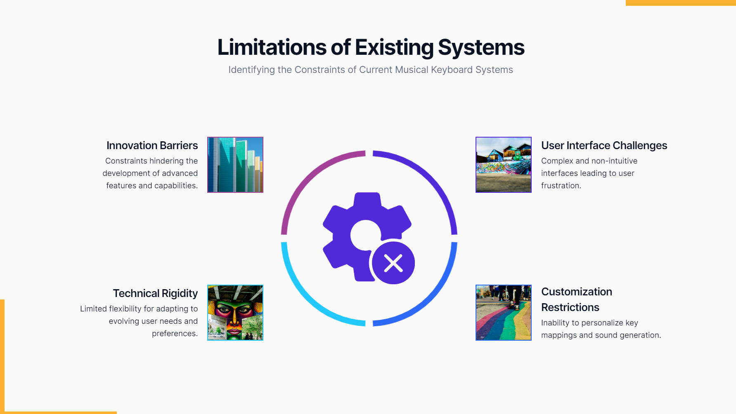

Slide 8
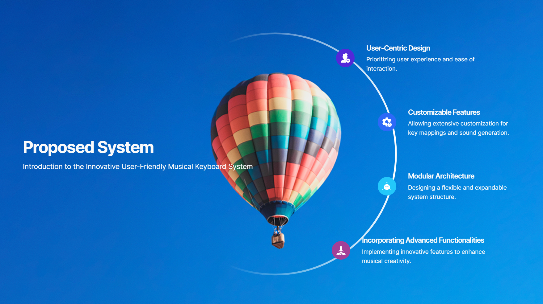

Slide 9
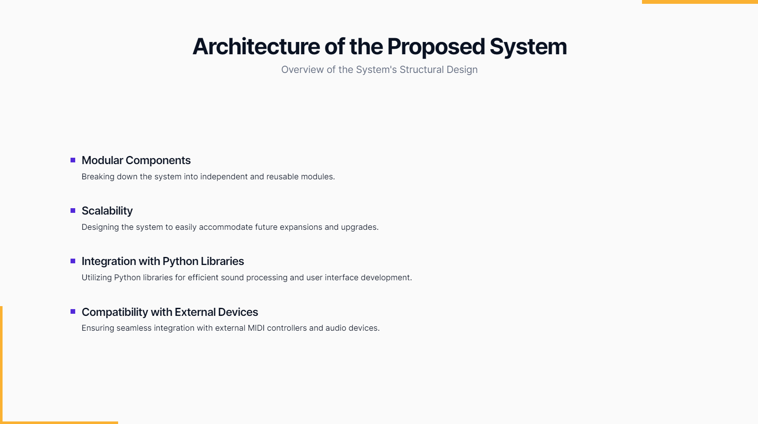

Slide 10
Overview of MIDI and Its Role in Music Production
Communication Standard
Performance Flexibility
Instrument Compatibility
It allows musicians to record and play back musical performances with precise control over various aspects such as note duration, pitch, and velocity.
MIDI (Musical Instrument Digital Interface) is the industry-standard protocol for communication between musical instruments and computers, enabling seamless interaction in music production.
MIDI facilitates compatibility among a wide variety of digital musical instruments, making it an essential part of modern music creation.

Slide 11
Setting up the Interactive MIDI Musical Keyboard Using Python
1
2
3
Connect
Install Libraries
Code Configuration

Slide 12
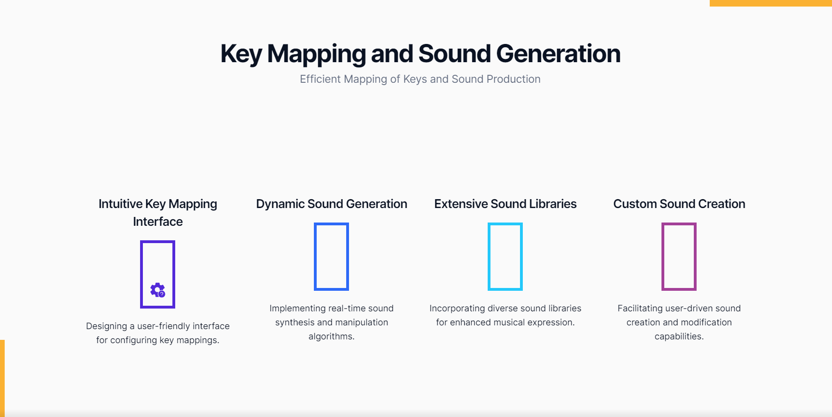

Slide 13
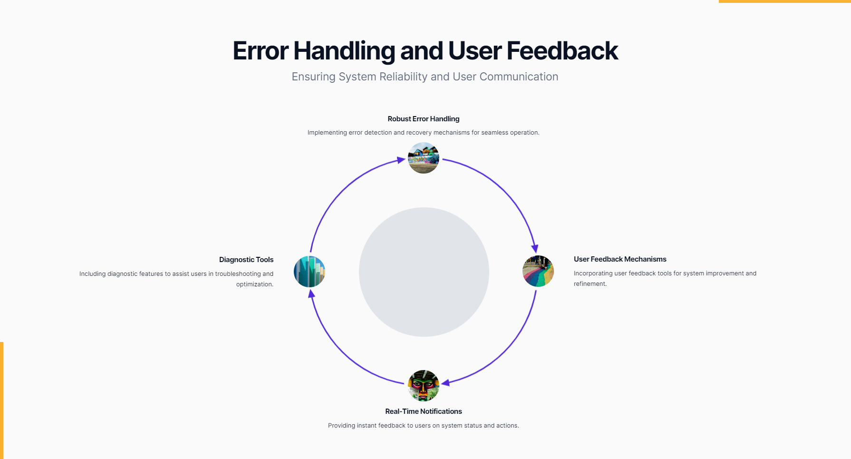

Slide 14
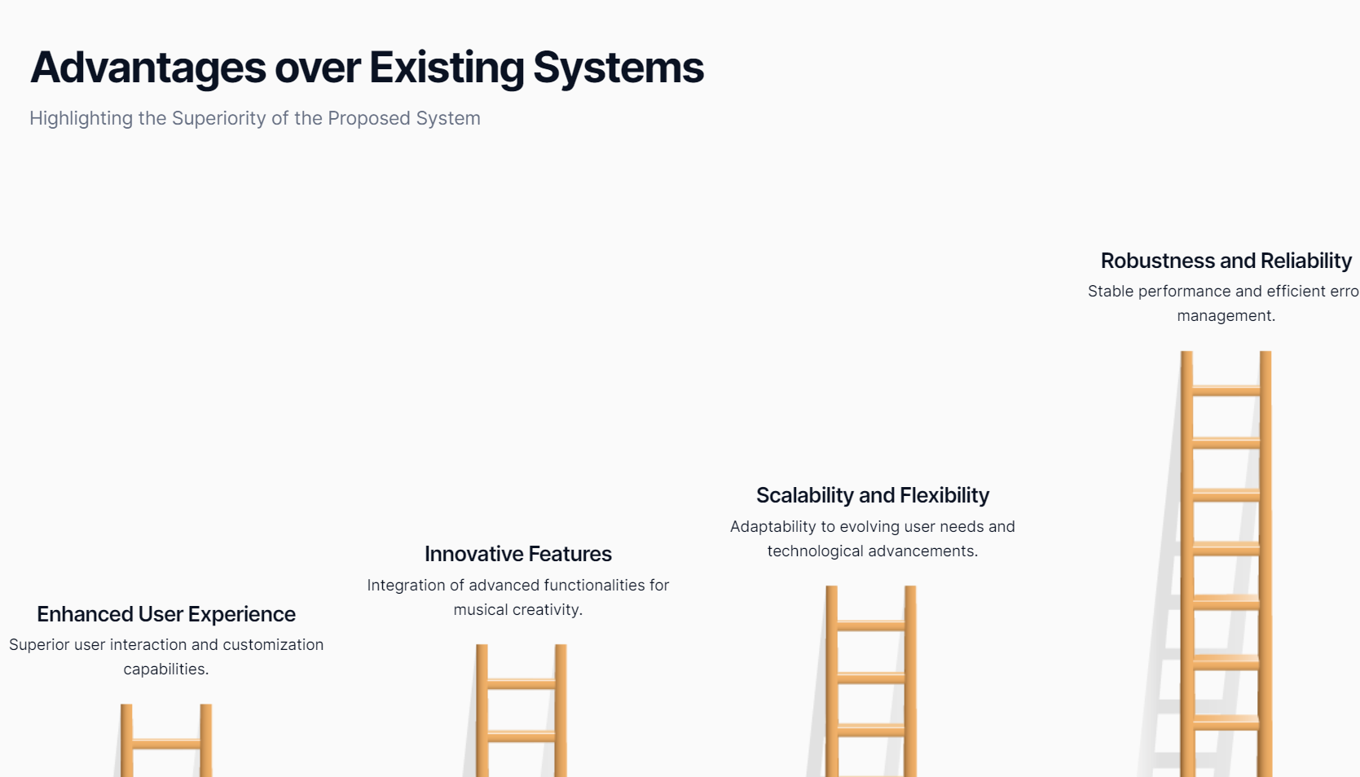

Slide 15
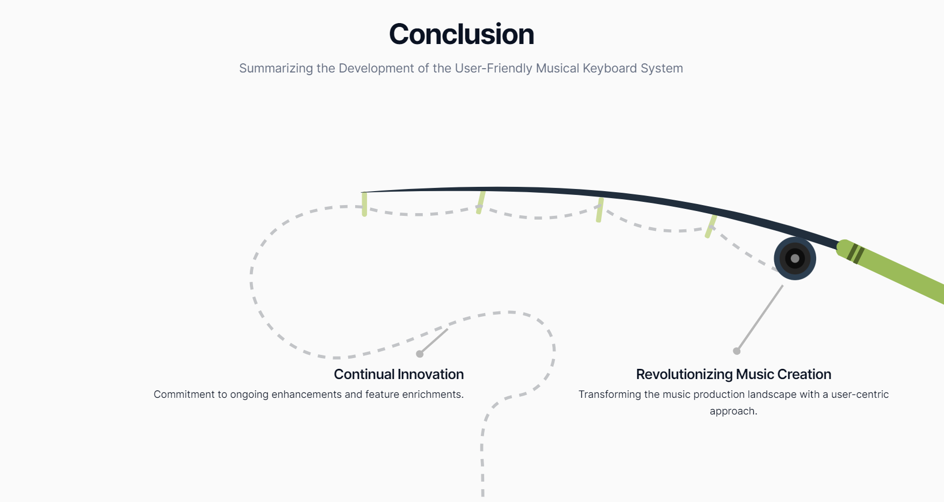

Slide 16
